Slide 1

<Result Analysis>
SRM INSTITUTE OF SCIENCE AND TECHNOLOGY
FACULTY OF ENGINEERING AND TECHNOLOGY
DEPARTMENT OF NETWORKING AND COMMUNICATIONS
18CSC101J- MINI PROJECT
Student 1 Reg No: Kushal Srivastava(RA2111026010136)
Student 2 Reg No: Harsh S Menon(RA2111026010141)
Student 3 Reg No: Thangala Nithinkumar reddy(RA2111026010117)
Student 4Reg No: Nithish Kumar W(RA2111026010120)
Branch/Section: CSE w/s AI&ML/T1
Batch No:B1
Lab Instructor name: Dr. M Shobana

Slide 2
Table of contents
Introduction
Objectives
Algorithm
Flowchart
Modules
Results and Discussion
Snapshots of the result
Sample Coding
References

Slide 3
Introduction
Examination cell otherwise known as exam cell is an innate part of any college management system. As we all are aware of the fact that examination is the vital and crucial issue in any engineering student’s life. Hence, management of this system requires a lot of effort. The basic challenge of an institution is to carry out result analysis from each and every corner of the students performance, track and resolve various students issues before and after examination and manage the whole of these operations in a flawless manner and deliver quality result oriented education.
If we just glance on a day to day basis, there are most basic problems faced by an institution.
a) Operations are mostly carried out in administrative offices.
b) Procedures are highly administrative.
c) Information needs to be updated from time to time.
d) Information is inconsistent.
e) Functionality is divided between certain organized units.
So to curb all these problems result analysis automation is used. This reduces much paper work and burden of storage.

Slide 4
Objectives
Replace Manual Processing System With Automated one
Result Of The Student Will Be Generated Automatically
The System Represents Students By The Student ID And The Name
The Student Information And The Specification Are Given By This Report Automation Has To Be Done Based On Their Result
Reduces The Chances Of Malpractices Associated In A Manual System
Reduces The Workload Involved In Processing
High Performance Is Ensured Using This Result Analysis Automation

Slide 5
Algorithm
Step 1 - START
Step 2 - Define Struct student
declare variables firstName, roll, marks
Step 3 - Create struct variable s
Step 4 - declare n, i, j, num
Step 5 - get value of n
Step 6 - for i in range(1,n)
store i+1 value in s[i].roll vaiable
get and store the first name in s[i].firstName variable
get and store the marks in s[i].marks variable
end loop
Step 7 - declare a variable choice
Step 8 - print the choice options
Step 9 - get the value of choice

Slide 6
Algorithm
Step 10 - switch case with choice input
First case for displaying information
for i in range (1,n)
print the roll number, first name, marks
Second case for displaying percentage
get the value of roll number
get the marks from struct and store in num variable
Calculate percentage by (num/500)*100 and store in per variable
display the percentage
Third Case for displaying Remarks
get the value of roll number
calculate Remarks
if marks>=450 and marks<500
print Outstanding

Slide 7
Algorithm
else if marks>=400 and marks<450
print Very Good
else if marks>=350 and marks<400
print Good
else if marks>=300 and marks<350
print Average
else
print Below average
Default case
print Invalid Choice
Step 11 - while choice not equal to zero
call getchar function
Step 12 - STOP

Slide 8
Flowchart
START
Get data from Student and Store
Get Choice from Student
Choice 1
Yes
Display Student Data
No
Choice 2
Yes
Display Percentage
No
Choice 3
Yes
Display Remarks
No
STOP

Slide 9
Modules
Entering students roll number
Entering students name
Entering marks
Calculating percentage
Remarks

Slide 10
Result And Discussions
By running the code, first it displays to enter the number of students after selecting number of students it displays to enter the students name later it display to enter marks there we can enter the marks of the student.
After completion these it displays 1 as display record, 2 as to see percentage, 3 as view remarks, 0 to exit and it asked to enter the choice based on entering your choice we can see the students record, percentage and remarks by entering the students roll number

Slide 11
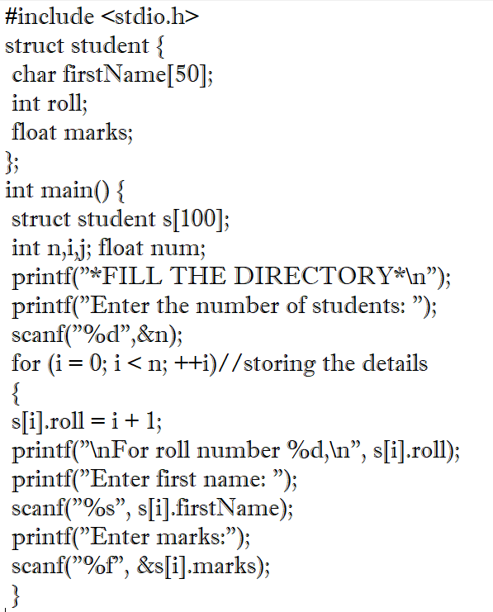

Slide 12
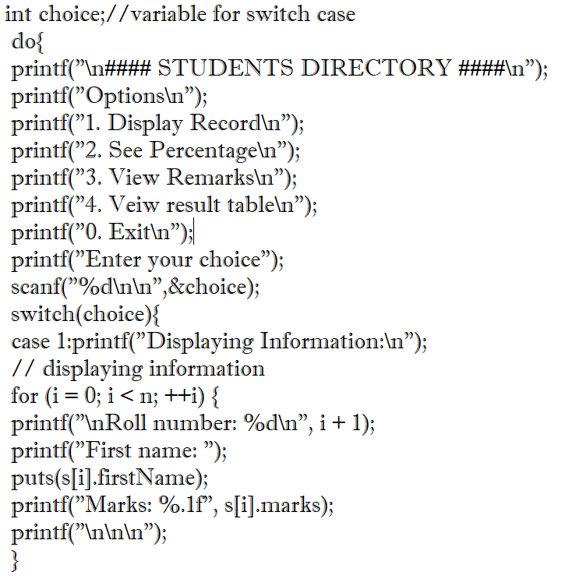

Slide 13
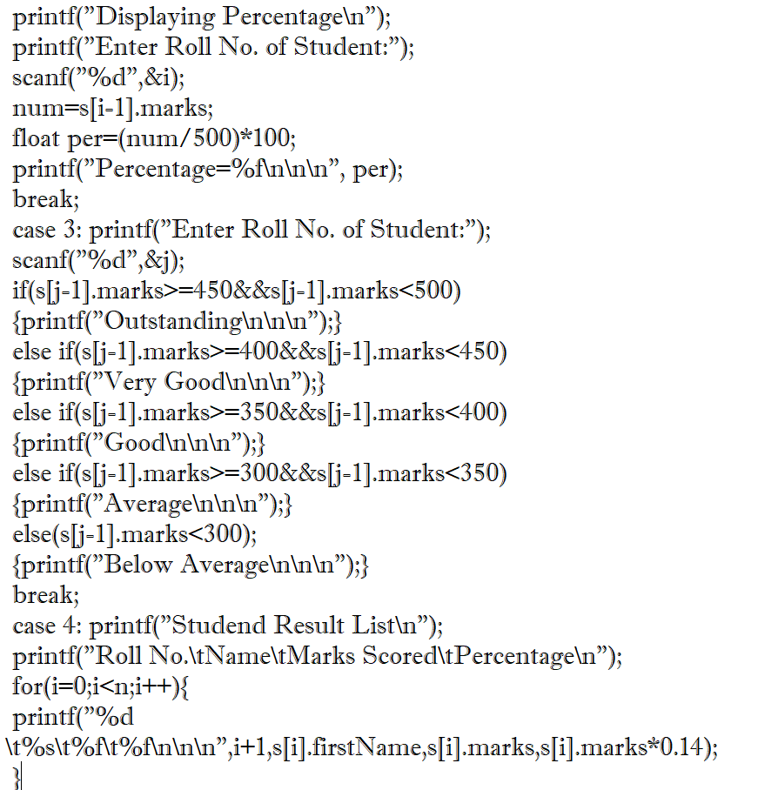

Slide 14
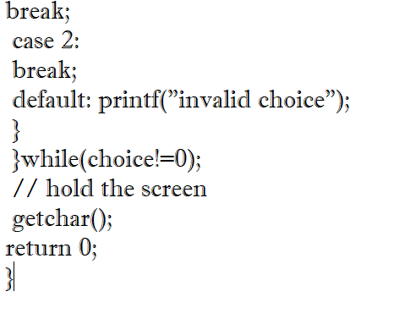

Slide 15
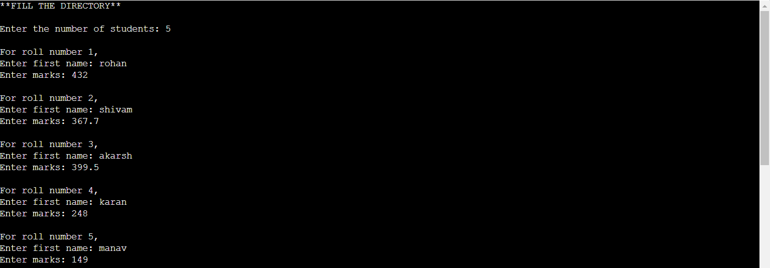
Sample Coding

Slide 16
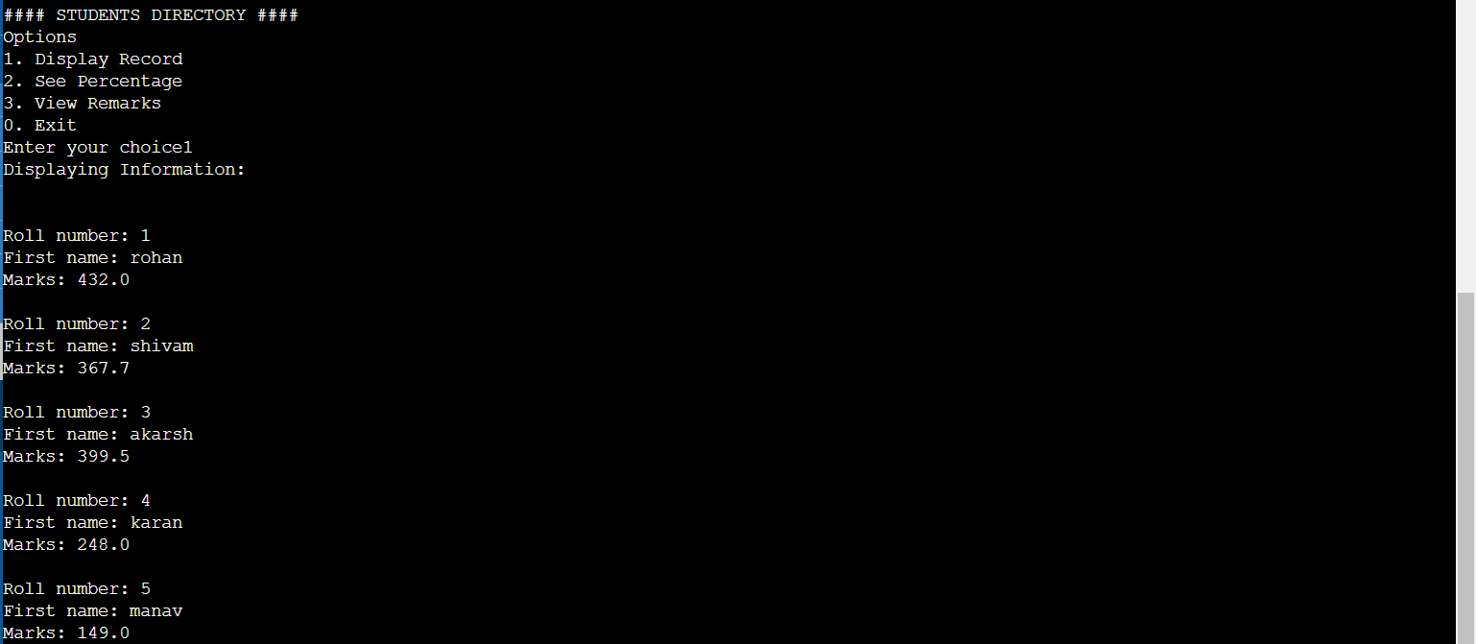
Sample Coding

Slide 17
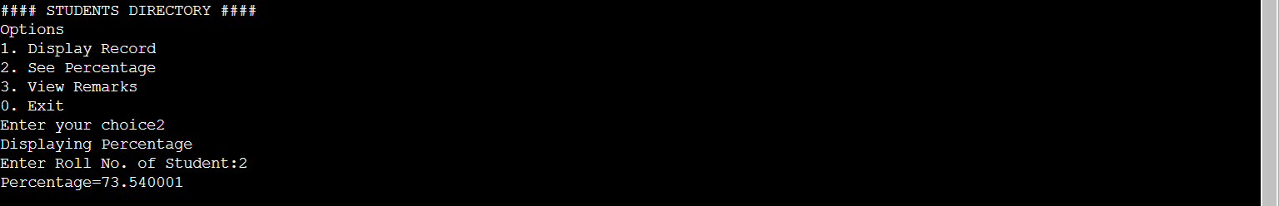
Sample Coding

Slide 18
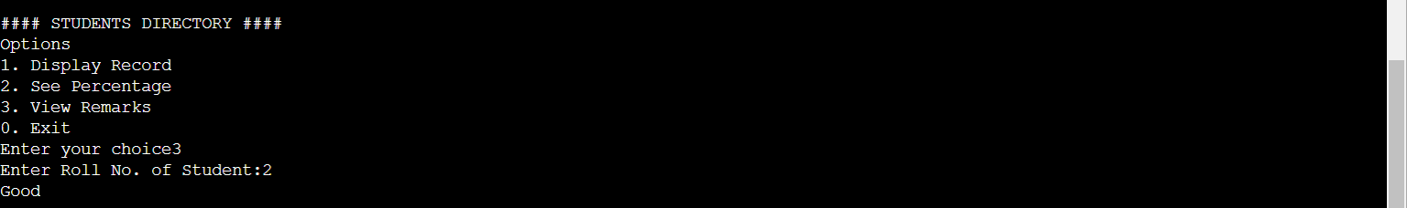
Sample Coding

Slide 19
References
Stacksoverflow.com
Notesformsc.org
Programiz.com

